Slide 1


Slide 2

Functional OOP,
Clojure Style
Yoav Rubin

Slide 3
About me
Software engineer at IBM Research - Haifa
  Development of development environments
  Large scale products
  to small scale research
  projects
Lecture the course “Functional programming on the JVM” in Haifa University
{:name Yoav Rubin,
:email yoavrubin@gmail.com,
:blog http://yoavrubin.blogspot.com,
:twitter @yoavrubin}

Slide 4
First thing first

Slide 5


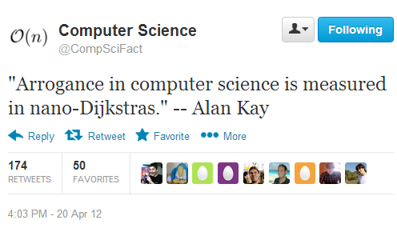
Alan Kay
Edsger W. Dijkstra

Slide 6
“Perspective is worth 80 IQ points”
Alan Kay

Slide 7
Agenda
OOP
Clojure
in

Slide 8
What’s in a software
Data types that describe the elements of the domain (nouns)
State changing operations (verbs)

Slide 9
The software matrix
Type \ functionality | f1 | f2 | f3 | f4
T1 | X | X
T2 |  | X
T3 |  |  | X
T4 | X | X | X | X

Slide 10
The software matrix
Type \ functionality | f1 | f2 | f3 | f4
T1 | X | X
T2 |  | X
T3 |  |  | X
T4 | X | X | X | X
Data types, nouns

Slide 11
The software matrix
Type \ functionality | f1 | f2 | f3 | f4
T1 | X | X
T2 |  | X
T3 |  |  | X
T4 | X | X | X | X
API, verbs, interfaces

Slide 12
The software matrix
Type \ functionality | f1 | f2 | f3 | f4
T1 | X | X
T2 |  | X
T3 |  |  | X
T4 | X | X | X | X
implementations of operation_{x} by Type_{y}

Slide 13


Data directed programming
Deciding which function to use based on given data
SICP
The expression problem
How to add rows and columns to the matrix without recompiling while preserving static typing
Philip Wadler

Slide 14
Let’s talk OOP
Abstraction
The rows are the classes
  The domain abstractions we define and use
  Which can hide within them their internal state
The column headers are interfaces
  Which allow polymorphic usage
Marked cell in row X and column Y signifies that class X implements interface Y
  Saying that the implementation itself resides in class Z means that X is-a Z

Slide 15
Let’s talk OOP
The rows are the classes
  The domain abstractions we define and use
  Which can hide within them their internal state
The column headers are interfaces
  Which allow polymorphic usage
Marked cell in row X and column Y signifies that class X implements interface Y
  Saying that the implementation itself resides in class Z means that X is-a Z
Information hiding

Slide 16
Let’s talk OOP
The rows are the classes
  The domain abstractions we define and use
  Which can hide within them their internal state
The column headers are interfaces
  Which allow polymorphic usage
Marked cell in row X and column Y signifies that class X implements interface Y
  Saying that the implementation itself resides in class Z means that X is-a Z
Polymorphism

Slide 17
Let’s talk OOP
The rows are the classes
  The domain abstractions we define and use
  Which can hide within them their internal state
The column headers are interfaces
  Which allow polymorphic usage
Marked cell in row X and column Y signifies that class X implements interface Y
  Saying that the implementation itself resides in class Z means that X is-a Z
Inheritance

Slide 18
Inheritance
Type \ functionality | f1 | f2 | f3 | f4
T1 | X | X
T2 |  | X
T3 |  |  | X
T4 | X | X |  | X
T4 can say that it is a T3
and its implementation of f3 is found at T3
X

Slide 19
OOP on the matrix
The rows are the classes
  The domain abstractions we define and use
  Which can hide within them their internal state
The column headers are interfaces
  Which allow polymorphic usage
Marked cell in row X and column Y signifies that class X implements interface Y
  Saying that the implementation itself resides in Class Z means that X is-a Z

Slide 20
How is it all related to Clojure?

Slide 21
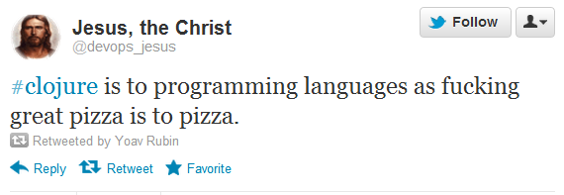
What is Clojure

Slide 22
What is Clojure
A Lisp
A functional language
Dynamically typed
Emphasis on immutability
Treats concurrency as an elementary part of life
  Not as a burden
Compiles to bytecode
  Of the JVM / CLR / JS (as the web’s bytecode)
Excellent “great ideas to WTF” ratio

Slide 23
General structure
A Clojure project is built of namespaces
In each namespace there are functions and data elements
Functions can be either public or private
  Either visible or not visible outside of the namespace
Functional Information hiding

Slide 24
How to define rows in Clojure?

Slide 25
Creating new types
Metaobjects – a mechanism that allows description and creation of new datatypes
We can create our own metaobjects
  E.g., a map that one of its key is “type”
In Clojure there are two metaobjects
  Type
  Record

Slide 26
The Type metaobject
Upon definition we need to provide:
  Name
  Member fields
  APIs to implement and their implementation
    Override methods from Object, interfaces, protocols (soon)
Cannot introduce new APIs to the matrix
Can be made mutable

Slide 27
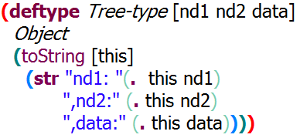
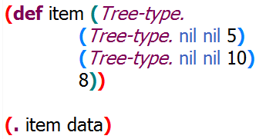
The type metaobject
Definition:
Instantiation:
Usage:

Slide 28
Two main use cases
You really know what you are doing
You’re doing it wrong

Slide 29
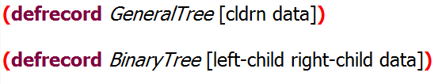
The Record metaobject
Similar to the Type metaobject
Provides a map like behavior
No mutability

Slide 30
So far in the software matrix
Added new rows
  New types / records
  No new APIs
Associate with an existing column
Functional Abstraction
Polymorphism

Slide 31
How to define columns in Clojure?

Slide 32
Adding new APIs
New APIs for one type
  just add a new function
Problem: how to handle more types?
Naïve solution: a simple dispatcher

Slide 33
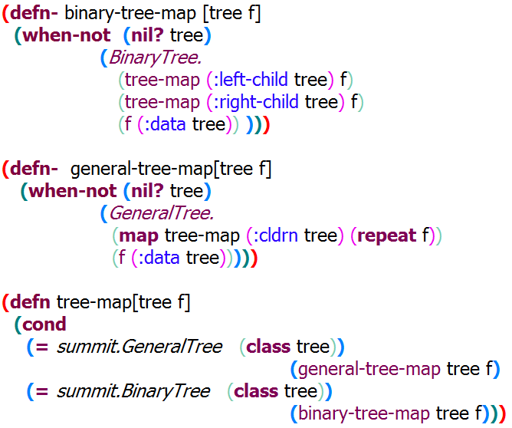

Slide 34
Now there’s a new tree in town

Slide 35
What can a developer do?
Re-write the existing tree-map function
  Because editing legacy code is fun…
Create another tree-map in another namespace and qualify its calls
  Name collisions
Create tree-map2
  Complicating both developer’s and user’s code

Slide 36
A deeper look
New column header (API)
Type \ functionality | f1 | f2 | f3 | tree-map
GeneralTree | X | X |  | X
YetAnotherType |  | X
BinaryTree |  |  | X | X
Two implementations
QuadTree
?
Tree-map did too much!!!

Slide 37
In the software matrix:
Need to decomplect the creation of columns headers from cell marking
Or in software design language:
We need to separate the definition of an API from its implementation

Slide 38
Creating abstract APIs
No concrete implementation
Define a semantic unit
  A set of behaviors that compose an API
In another place define the mapping between data types and the API
  Marking of a cell in the matrix

Slide 39

Protocol
A set of several function signatures
  Just the signature, without implementation
  Dispatch is done based on the run-time type
The protocol name
A function signature
(there can be several of these)

Slide 40
Protocols and types
The linking of a protocol to a type can be done not as part of the definition of the type
This results in the possibility to extend existing, compiled types
  Extend String
  Extend even nil

Slide 41
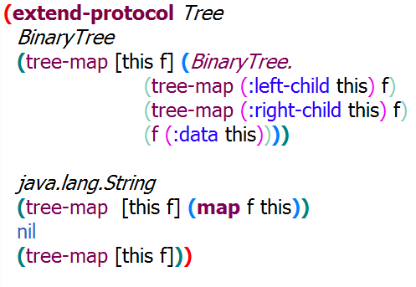

Slide 42
Added to an existing type a new API
Without changing the type
Functional polymorphism

Slide 43
Still, there are limitations
Protocols allow type based dispatch only

Slide 44
Multi methods
Polymorphism which is based on a user defined dispatching function
The result of the execution of the dispatch function determines which implementation will be executes

Slide 45
This is the exposed API
take-care-of
(tco-moon)
::moon
(dispatch-fn)
dispatcher
::sun
(tco-sun)
::lightning
(tco-lightning)

Slide 46


The multi method name
The dispatching function
Meanwhile, at other namespaces

Slide 47
Multi method
We can use the same API for different data elements
All we need to know is that they obey that API
We can introduce new APIs for existing types
Functional polymorphism

Slide 48
Is-a relationship
We can define that A is-a B
The dispatcher would handle A the same way that it handles B
(derive ::A ::B)
  if the dispatch function return ::A
  if no value is found for ::A in the dispatcher
  Handle it as ::B

Slide 49
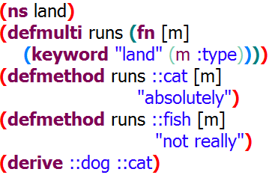
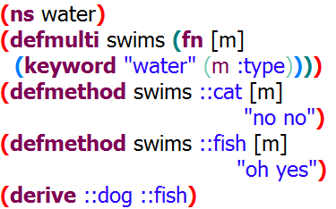
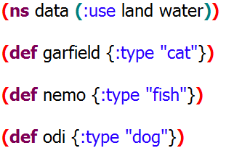
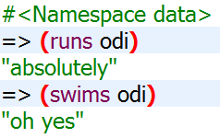
Is-a relationship

Slide 50
Why did it work
Derive harms the referential transparency of the multi method
  The return value may differ if (derive…) was called
  Referential transparency is our friend
Derive works only with namespace bound keywords
  Those that start with ::
Clojure localizes the effect of mutability to the namespace

Slide 51
Type \ functionality | f1 | f2 | f3 | f4
T1 | X | X
T2 |  | X
T3 |  |  | X
T4 | X | X | X | X
T4 isa T2 (for f2)
T4 isa T3 (for f3)
Functional inheritance

Slide 52
Summary
We’ve seen
  Functional abstraction
  Functional information hiding
  Functional polymorphism
  Functional inheritance

Slide 53
Summary
We’ve seen functional
  Abstraction
  Information hiding
  Polymorphism
  Inheritance

Slide 54
Summary
We’ve seen functional OOP
Clojure Style

Slide 55

Thank
You!

